Slide 1
FDM & TDM
(additional learning materials)
Sujoy Mukherjee

Slide 2
Frequency Division Multiplex
Separation of spectrum into smaller frequency bands
Channel gets band of the spectrum for the whole time
Advantages:
  no dynamic coordination needed
  works also for analog signals
Disadvantages:
  waste of bandwidth
  if traffic distributed unevenly
  inflexible
  guard spaces
Channels
k_{i}
k₃
k₄
k₅
k₆
c
f
t

Slide 3
Time Division Multiplex
Channel gets the whole spectrum for a certain amount of time
Advantages:
  only one carrier in the
  medium at any time
  throughput high even
  for many users
Disadvantages:
  precise
  synchronization
  necessary
Channels k_{i}
k₁
k₂
k₃
k₄
k₅
k₆
c
f
t

Slide 4
Time and Frequency Division Multiplex
A channel gets a certain frequency band for a certain amount of time (e.g. GSM)
Advantages:
  better protection against tapping
  protection against frequency
  selective interference
  higher data rates compared to
  code multiplex
Precise coordination
required
Channels k_{i}
k₁
k₂
k₃
k₄
k₅
k₆
c
f
t

Slide 5
Code Division Multiplex
Channels k_{i}
k₁
k₂
k₃
k₄
k₅
k₆
Each channel has unique code
All channels use same spectrum at same time
Advantages:
  bandwidth efficient
  no coordination and synchronization
  good protection against interference
Disadvantages:
  lower user data rates
  more complex signal regeneration
Implemented using spread spectrum technology
c
f
t

Slide 6
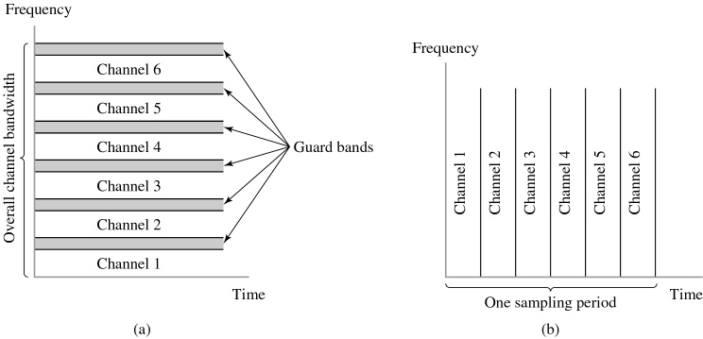
Two basic forms of multiplexing.
(a) Frequency-division multiplexing (FDM) (with guardbands).
(b) Time-division multiplexing (TDM); no provision is made here for synchronizing pulses.
Multiplexing
FDM
TDM

Slide 7
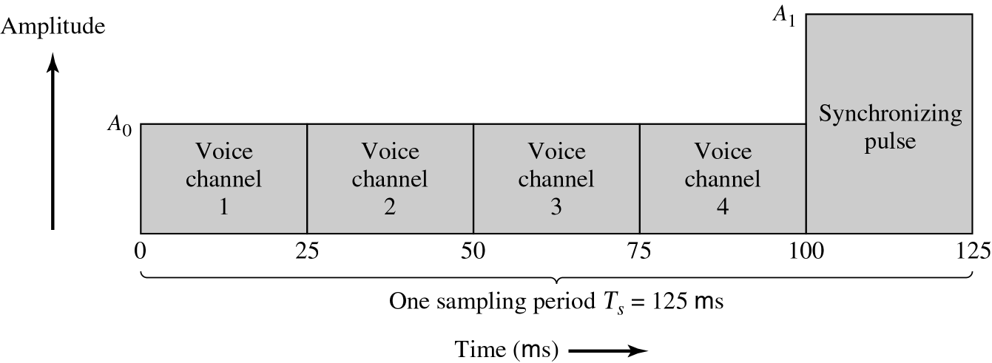
Composition of one frame of a multiplexed PAM signal incorporating four voice-signals and a synchronizing pulse.
TDM

Slide 8
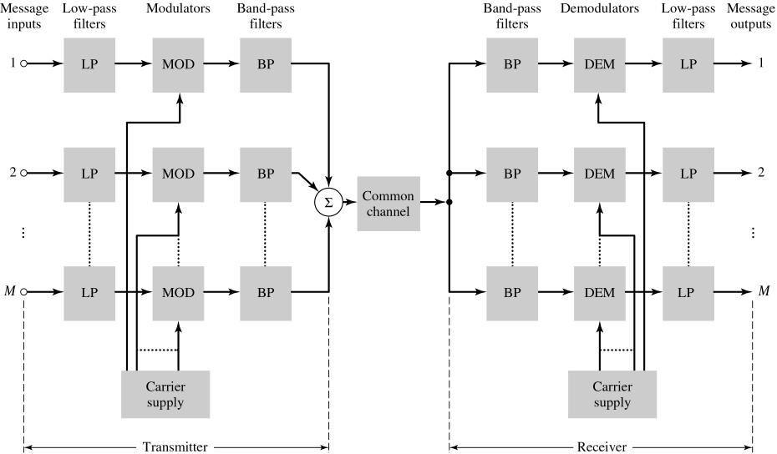
Block diagram of FDM system, showing the important constituents of the transmitter and receiver.
Frequency Division Multiplexing (FDM)

Slide 9
Time Division Multiplexing
Definition: Time Division Multiplexing (TDM) is the time interleaving of samples from several sources so that the information from these sources can be transmitted serially over a single communication channel.
At the Transmitter
Simultaneous transmission of several signals on a time-sharing basis.
Each signal occupies its own distinct time slot, using all frequencies, for the duration of the transmission.
Slots may be permanently assigned on demand.
At the Receiver
Decommutator (sampler) has to be synchronized with the incoming waveform → Frame Synchronization
Low pass filter
ISI – poor channel filtering
Feedthrough of one channel's signal into another channel -- Crosstalk
Applications of TDM: Digital Telephony, Data communications, Satellite Access,
Cellular radio.

Slide 10
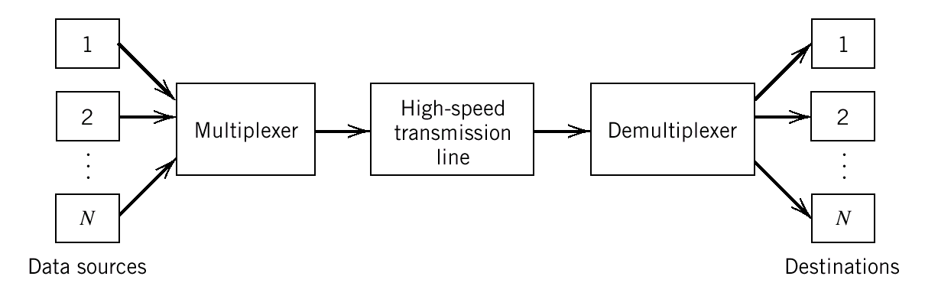
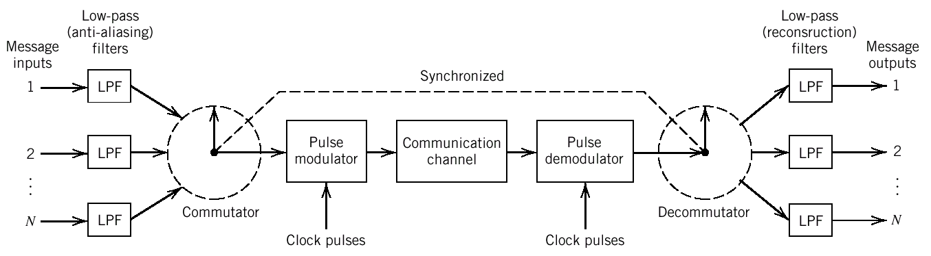
Time Division Multiplexing
Conceptual diagram of multiplexing-demultiplexing.
PAM TDM System

Slide 11
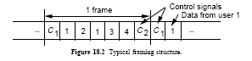
Block diagram of TDM system.
PAM TDM System
A Typical Framing Structure for TDM

